Slide 1
Relations And Their Types

Slide 2
ORDERED PAIR:
An ordered pair (a, b) consists of two elements “a” and “b” in which “a” is the first element and “b” is the second element.
The ordered pairs (a, b) and (c, d) are equal if, and only if, a= c and b = d.
Note that (a, b) and (b, a) are not equal unless a = b.

Slide 3
EXERCISE:
Find x and y given (2x, x + y) = (6, 2)
SOLUTION:
Two ordered pairs are equal if and only if the
corresponding components are equal. Hence, we obtain the equations: 2x = 6 (1)
and x + y = 2 (2)
Solving equation (1) we get x = 3 and when substituted in (2) we get y = -1.

Slide 4
CARTESIAN PRODUCT OF TWO SETS:
Let A and B be sets. The Cartesian product of A and B, denoted by A × B (read as “A cross B”) is the set of all ordered pairs (a, b), where a is in A and b is in B.
Symbolically:
A × B = {(a, b)| a ∈ A and b ∈ B}
NOTE: If set A has m elements and set B has n elements then A ×B has m × n elements.

Slide 5
EXAMPLE:
Let A = {1, 2}, B = {a, b, c} then
A × B = {(1, a), (1, b), (1, c), (2, a), (2, b), (2, c)}
B × A = {(a, 1), (a, 2), (b, 1), (b, 2), (c, 1), (c, 2)}
A × A = {(1, 1), (1,2), (2, 1), (2, 2)}
B × B = {(a, a), (a, b), (a, c), (b, a), (b, b), (b, c), (c, a), (c, b),(c, c)}
REMARK:
1. A × B ≠ B × A for non-empty and unequal sets A and B.
2. A × φ = φ × A = φ
3. | A × B| = |A| × |B|

Slide 6
CARTESIAN PRODUCT OF MORE THAN TWO SETS:
The Cartesian product of sets A₁, A₂, …, A_{n}, denoted A₁× A₂ × … ×A_{n,} is the set of all ordered n-tuples (a₁, a₂, …, a_{n}) where a₁ ∈A₁, a₂ ∈A₂,…, a_{n} ∈A_{n.}
Symbolically:
A₁× A₂ × … ×A_{n} ={(a₁, a₂, …, a_{n}) | a_{i} ∈A_{i}, for i =1, 2, …, n}

Slide 7
BINARY RELATION:
Let A and B be sets. The binary relation R from A to B is a subset of A × B. When (a, b) ∈R, we say ‘a’ is related to ‘b’ by R, written aRb.
Otherwise, if (a, b) ∉R, we write a R b.

Slide 8
EXAMPLE:
Let A = {1, 2}, B = {1, 2, 3}
Then A × B = {(1, 1), (1, 2), (1, 3), (2, 1), (2, 2), (2, 3)}
Let
R₁={(1,1), (1, 3), (2, 2)}
R₂={(1, 2), (2, 1), (2, 2), (2, 3)}
R₃={(1, 1)}
R₄= A × B
R₅= ∅
All being subsets of A × B are relations from A to B.

Slide 9
DOMAIN OF A RELATION:
The domain of a relation R from A to B is the set of all first elements of the ordered pairs which belong to R denoted by Dom(R).
Symbolically,
Dom (R) = {a ∈A | (a, b) ∈R}

Slide 10
RANGE OF A RELATION:
The range of a relation R from A to B is the set of all second elements of the ordered pairs which belong to R denoted Ran(R).
Symbolically,
Ran(R) = {b ∈B | (a, b) ∈ R}

Slide 11
EXERCISE:
Let A = {1, 2}, B = {1, 2, 3},
Define a binary relation R from A to B as follows:
R = {(a, b) ∈A × B | a < b}
Then
Find the ordered pairs in R.
Find the Domain and Range of R.
Is 1R3, 2R2?

Slide 12
SOLUTION:
Given A = {1, 2}, B = {1, 2, 3},
A × B = {(1,1), (1,2), (1,3), (2,1), (2,2), (2,3)}
a. R = {(a, b) ∈A × B | a < b}
R = {(1,2), (1,3), (2,3)}
b. Dom(R) = {1,2}=A and Ran(R) = {2, 3} ⊆ B
c. Since (1, 3)∈R so 1R3
But (2, 2) ∉R so 2 is not related with 2 or 2 R 2

Slide 13
EXERCISE:
Find all binary relations from {0,1} to {1}
Let A = {0,1} & B = {1}
Then A × B = {(0,1), (1,1)}
All binary relations from A to B are in fact all subsets of A ×B, which are:
R₁= ∅
R₂={(0,1)}
R₃={(1,1)}
R₄={(0,1), (1,1)} = A × B

Slide 14
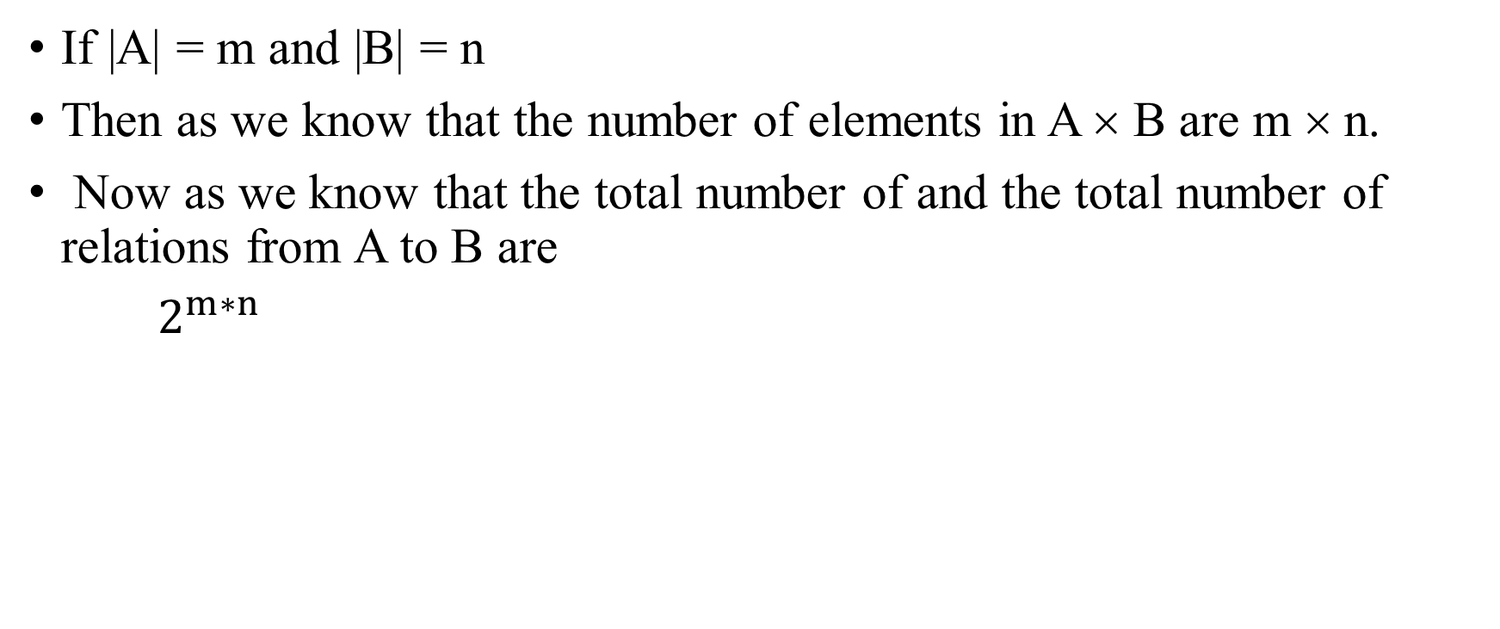
REMARK:
If |A| = m and |B| = n
Then as we know that the number of elements in A × B are m × n.
Now as we know that the total number of and the total number of relations from A to B are
$2^{m∗n}$

Slide 15
RELATION ON A SET:
A relation on the set A is a relation from A to A.
In other words, a relation on a set A is a subset of A × A.
EXAMPLE:
Let A = {1, 2, 3, 4}
Define a relation R on A as
(a,b)∈ R iff a divides b {symbolically written as a | b}
Then R = {(1,1), (1,2), (1,3), (1,4), (2,2), (2,4), (3,3), (4,4)}

Slide 16
REMARK:
For any set A
A × A is known as the universal relation.
∅ is known as the empty relation.

Slide 17
EXERCISE:
Define a binary relation E on the set of the integers Z, as follows:
for all m,n ∈ Z, m E n ⇔ m – n is even
a. Is 0E0? Is 5E2? Is (6,6) ∈ E? Is (-1,7) ∈ E?
b. Prove that for any even integer n, nE0.

Slide 18
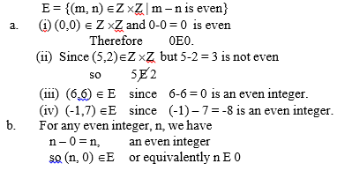
SOLUTION

Slide 19
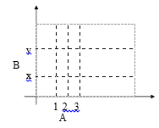
COORDINATE DIAGRAM (GRAPH) OF A RELATION:
Let A = {1, 2, 3} and B = {x, y}
Let R be a relation from A to B defined as
R = {(1, y), (2, x), (2, y), (3, x)}
The relation may be represented in a coordinate diagram as follows:

Slide 20
EXAMPLE:
Draw the graph of the binary relation C from R to R defined as follows:
for all (x, y) ∈R × R, (x, y) ∈C ⇔ x² + y² = 1

Slide 21
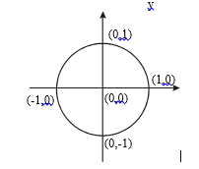
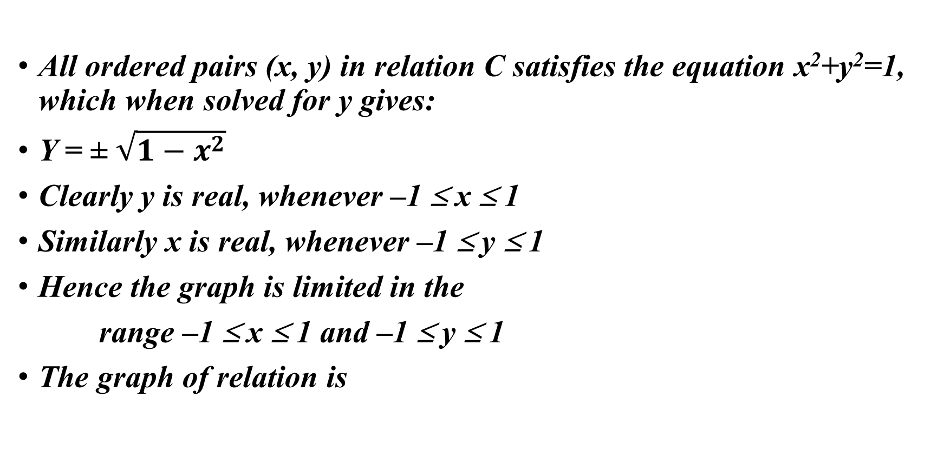
SOLUTION
All ordered pairs (x, y) in relation C satisfies the equation x²+y²=1, which when solved for y gives:
Y = ± $\sqrt{1−x^{2}}$
Clearly y is real, whenever –1 ≤ x ≤ 1
Similarly x is real, whenever –1 ≤ y ≤ 1
Hence the graph is limited in the
range –1 ≤ x ≤ 1 and –1 ≤ y ≤ 1
The graph of relation is

Slide 22
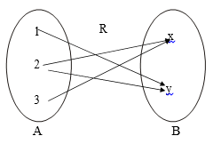
ARROW DIAGRAM OF A RELATION:
Let
A = {1, 2, 3}, B = {x, y} and R = {1,y), (2,x), (2,y), (3,x)}
be a relation from A to B. The arrow diagram of R is:

Slide 23
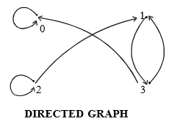
DIRECTED GRAPH OF A RELATION:
Let A = {0, 1, 2, 3}
and R = {(0,0), (1,3), (2,1), (2,2), (3,0), (3,1)}
be a binary relation on A.

Slide 24
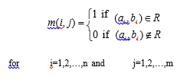
MATRIX REPRESENTATION OF A RELATION
Let A = {a₁, a₂, …, a_{n}} and B = {b₁, b₂, …, b_{m} }.
Let R be a relation from A to B.
Define the matrix M of order n × m

Slide 25
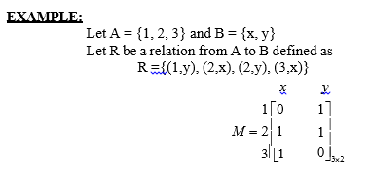

Slide 26

EXAMPLE:
For the relation matrix.
List the set of ordered pairs represented by M.
Draw the directed graph of the relation.

Slide 27
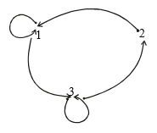
SOLUTION:
The relation corresponding to the given Matrix is
R = {(1,1), (1,3), (2,1), (3,2), (3,3)}
And its Directed graph is given below

Slide 28
EXERCISE:
Let A = {2, 4} and B = {6, 8, 10}
and define relations R and S from A to B as follows:
for all (x,y) ∈A × B, x R y ⇔ x | y
for all (x,y) ∈A × B, x S y ⇔ y – 4 = x
State explicitly which ordered pairs are in A × B, R, S, R∪ S and R∩S.

Slide 29
SOLUTION
A × B = {(2,6), (2,8), (2,10), (4,6), (4,8), (4,10)}
R = {(2,6), (2,8), (2,10), (4,8)}
S = {(2,6), (4,8)}
R ∪ S = {(2,6), (2,8), (2,10), (4,8)}= R
R ∩ S = {(2,6), (4,8)}= S

Slide 30
Types of Relations

Slide 31
REFLEXIVE RELATION:
Let R be a relation on a set A. R is reflexive if and only if, for all a ∈ A, (a, a) ∈R or equivalently aRa. That is, each element of A is related to itself.
REMARK
R is not reflexive iff there is an element “a” in A such that
(a, a) ∉R. That is, some element “a” of A is not related to itself.

Slide 32
EXERCISE:
Let A = {1, 2, 3, 4} and define relations R₁, R₂, R₃, R₄ on A as follows:
R₁ = {(1, 1), (3, 3), (2, 2), (4, 4)}
R₂ = {(1, 1), (1, 4), (2, 2), (3, 3), (4, 3)}
R₃ = {(1, 1), (1, 2), (2, 1), (2, 2), (3, 3), (4, 4)}
R₄ = {(1, 3), (2, 2), (2, 4), (3, 1), (4, 4)}
Then,
R₁ is reflexive, since (a, a) ∈R₁ for all a ∈A.
R₂ is not reflexive, because (4, 4) ∉R₂.
R₃ is reflexive, since (a, a) ∈R₃ for all a ∈A.
R₄ is not reflexive, because (1, 1) ∉R₄, (3, 3) ∉R₄

Slide 33
DIRECTED GRAPH OF A REFLEXIVE RELATION:
The directed graph of every reflexive relation includes an arrow from every point to the point itself (i.e., a loop).
EXAMPLE :
Let A = {1, 2, 3, 4} and define relations R₁, R₂, R₃, and R₄ on A by
R₁ = {(1, 1), (3, 3), (2, 2), (4, 4)}
R₂ = {(1, 1), (1, 4), (2, 2), (3, 3), (4, 3)}
R₃ = {(1, 1), (1, 2), (2, 1), (2, 2), (3, 3), (4, 4)}
R₄ = {(1, 3), (2, 2), (2, 4), (3, 1), (4, 4)}
Then their directed graphs are the following:

Slide 34
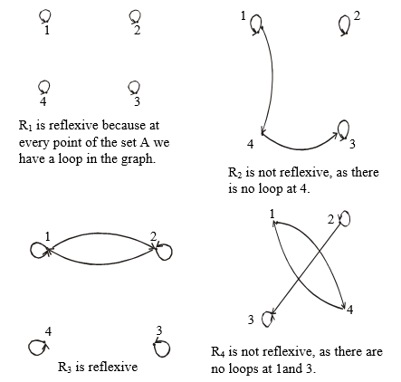

Slide 35

MATRIX REPRESENTATION OF A REFLEXIVE RELATION:
Let A = {a₁, a₂, …, a_{n}}. A Relation R on A is reflexive if and only if (a_{i}, a_{j}) ∈R ∀ i=1,2, …,n.
Accordingly, R is reflexive if all the elements on the main diagonal of the matrix M representing R are equal to 1.
EXAMPLE:
The relation R = {(1,1), (1,3), (2,2), (3,2), (3,3)} on A = {1,2,3}
represented by the following matrix M, is reflexive.

Slide 36
SYMMETRIC RELATION
Let R be a relation on a set A. R is symmetric if, and only if,
for all a, b ∈ A, if (a, b)∈R, then (b, a) ∈R.
That is, if aRb then bRa.
REMARK
R is not symmetric iff there are elements a and b in A such that (a, b) ∈R, but (b, a) ∉R.

Slide 37
EXAMPLE
Let A = {1, 2, 3, 4} and define relations R₁, R₂, R₃, and R₄on A as follows.
R₁ = {(1, 1), (1, 3), (2, 4), (3, 1), (4,2)}
R₂ = {(1, 1), (2, 2), (3, 3), (4, 4)}
R₃ = {(2, 2), (2, 3), (3, 4)}
R₄ = {(1, 1), (2, 2), (3, 3), (4, 3), (4, 4)}
Then R₁ is symmetric because for every order pair (a, b) in R₁also have (b, a) in R_{1.}
For example, we have (1, 3) in R₁ then we have (3, 1) in R_{1.} Similarly all other ordered pairs can be checked.
R₂ is also symmetric.
R₃ is not symmetric, because (2,3) ∈ R₃ but (3,2) ∉ R₃.
R₄ is not symmetric because (4,3) ∈ R₄ but (3,4) ∉ R₄.

Slide 38
DIRECTED GRAPH OF A SYMMETRIC RELATION
For a symmetric directed graph whenever there is an arrow going from one point of the graph to a second, there is an arrow going from the second point back to the first.

Slide 39
EXAMPLE
Let A = {1, 2, 3, 4} and define relations R₁, R₂, R₃ and R₄ on A by the directed graphs:
R₁ = {(1, 1), (1, 3), (2, 4), (3, 1), (4,2)}
R₂ = {(1, 1), (2, 2), (3, 3), (4, 4)}
R₃ = {(2, 2), (2, 3), (3, 4)}
R₄= {(1, 1), (2, 2), (3, 3), (4, 3), (4, 4)}

Slide 40
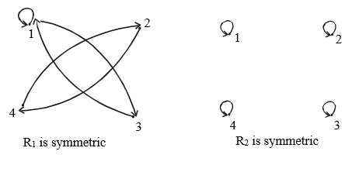
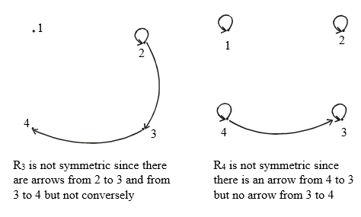

Slide 41
MATRIX REPRESENTATION OF A SYMMETRIC RELATION
Let A = {a₁, a₂, …, a_{n}}.
The relation R on A is symmetric if and only if for all a_{i}, a_{j} ∈ A,
if (a_{i}, a_{j}) ∈R then (a_{j}, a_{i})∈R.
Accordingly, R is symmetric if the elements in the ith row are the same as the elements in the ith column of the matrix M representing R. More precisely, M is a
symmetric matrix i.e. M = M^{t}

Slide 42

EXAMPLE:
The relation R = {(1,3), (2,2), (3,1), (3,3)}
on A = {1,2,3} represented by the following matrix M is symmetric.

Slide 43
TRANSITIVE RELATION
Let R be a relation on a set A. R is transitive
if and only if for all a, b, c ∈A, if (a, b) ∈R and (b, c) ∈R then (a, c) ∈R.
That is, if aRb and bRc then aRc.
In words, if any one element is related to a second and that second element is related to a third, then the first is related to the third.
Note:
The “first”, “second” and “third” elements need not to be distinct.

Slide 44
REMARK
R is not transitive iff there are elements a, b, c in A such that
if (a, b) ∈R and (b, c) ∈R but (a, c) ∉R.

Slide 45
EXAMPLE
Let A = {1, 2, 3, 4} and define relations R₁, R₂ and R₃ on A as follows: R₁ = {(1, 1), (1, 2), (1, 3), (2, 3)}
R₂ = {(1, 2), (1, 4), (2, 3), (3, 4)}
R₃ = {(2, 1), (2, 4), (2, 3), (3,4)}
Then R₁ is transitive because (1, 1), (1, 2) are in R, then to be transitive relation (1,2) must be there and it belongs to R.
Similarly for other order pairs. R₂ is not transitive since (1,2) and (2,3) ∈ R₂ but (1,3) ∉ R₂.
R₃ is transitive.

Slide 46
DIRECTED GRAPH OF A TRANSITIVE RELATION
For a transitive directed graph, whenever there is an arrow going from one point to the second, and from the second to the third, there is an arrow going directly from the first to the third.

Slide 47
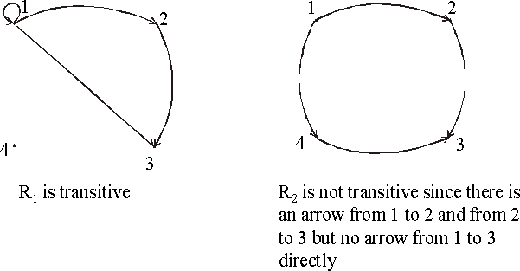
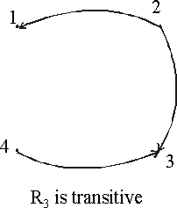
EXAMPLE
Let A = {1, 2, 3, 4} and define relations R₁, R₂ and R₃ on A by the directed graphs:
R₁ = {(1, 1), (1, 2), (1, 3), (2, 3)}
R₂ = {(1, 2), (1, 4), (2, 3), (3, 4)}
R₃ = {(2, 1), (2, 4), (2, 3), (3,4)}
SOLUTION:

Slide 48
EXERCISE:
Let A = {1, 2, 3, 4} and define the null relation φ and universal relation A × A on A. Test these relations for reflexive, symmetric and transitive properties.
SOLUTION:
Reflexive:
a) ∅ is not reflexive since (1,1), (2,2), (3,3), (4,4) ∉ ∅.
b) A × A is reflexive since (a,a) ∈ A × A for all a ∈ A.

Slide 49
Solution cont…
Symmetric
For the null relation ∅ on A to be symmetric, it must satisfy the implication: if (a,b) ∈ ∅ then (b, a) ∈ ∅.
Since (a, b) ∈ ∅ is never true, the implication is vacuously true or true by default. Hence ∅ is symmetric.
The universal relation A × A is symmetric, for it contains all ordered pairs of elements of A. Thus,
if (a, b) ∈ A × A then (b, a) ∈ A × A for all a, b in A.

Slide 50
Solution cont…
Transitive
The null relation ∅ on A is transitive, because the implication. if (a, b) ∈ ∅ and (b, c) ∈ ∅ then (a, c) ∈ ∅ is true by default,
since the condition (a, b) ∈ ∅ is always false.
The universal relation A × A is transitive for it contains all ordered pairs of elements of A.
Accordingly, if (a, b) ∈ A × A and (b, c) ∈ A × A then (a, c) ∈ A × A

Slide 51
EXERCISE:
Let A = {0, 1, 2} and
R = {(0,2), (1,1), (2,0)} be a relation on A.
Is R reflexive? Symmetric? Transitive?
Which ordered pairs are needed in R to make it a reflexive and transitive relation.

Slide 52
SOLUTION:
R is not reflexive, since 0 ∈ A but (0, 0) ∉R
and also 2 ∈ A but (2, 2) ∉R. R is clearly symmetric.
R is not transitive, since (0, 2) & (2, 0) ∈ R but (0, 0) ∉R.
For R to be reflexive, it must contain ordered pairs (0,0) and (2,2).
For R to be transitive,
we note (0,2) and (2,0) ∈ R but (0,0) ∉R.
Also (2,0) and (0,2) ∈R but (2,2)∉R.
Hence (0,0) and (2,2) are needed in R to make it a transitive relation.

Slide 53
EXERCISE:
Define a relation L on the set of real numbers R be defined as follows:
for all x, y ∈R, x L y ⇔ x < y.
Is L reflexive?
Is L symmetric?
Is L transitive?

Slide 54
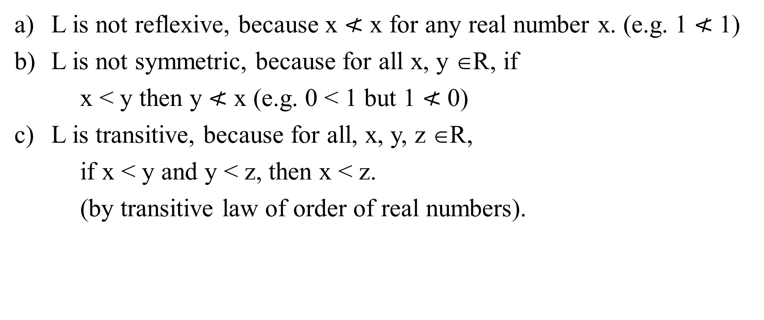
SOLUTION:
L is not reflexive, because x $≮$ x for any real number x. (e.g. 1 $≮$ 1)
L is not symmetric, because for all x, y ∈R, if
x < y then y $≮$ x (e.g. 0 < 1 but 1 $≮$ 0)
L is transitive, because for all, x, y, z ∈R,
if x < y and y < z, then x < z.
(by transitive law of order of real numbers).

Slide 55
EXERCISE:
Define a relation R on the set of positive integers Z as follows:
for all a, b ∈Z⁺, a R b iff a × b is odd.
Determine whether the relation is
reflexive
symmetric
transitive

Slide 56
SOLUTION:
Firstly, recall that the product of two positive integers is odd if and only if both of them are odd.
a. reflexive
R is not reflexive, because 2 ∈ Z⁺ but 2 R 2 for 2 × 2 = 4 which is not odd.
b. symmetric
R is symmetric, because
if a R b then a × b is odd or equivalently b × a is odd
( b × a = a × b) ⇒ b R a.
c. transitive
R is transitive, because if a R b then a × b is odd
⇒ both “a” and “b” are odd. Also bRc means b × c is odd
⇒ both “b” and “c” are odd.
Now if aRb and bRc, then all of a, b, c are odd and so a × c is odd. Consequently aRc.

Slide 57
EXERCISE:
Let A be the set of people living in the world today. A binary relation R is defined on A as follows:
for all p, q ∈A, pRq ⇔ p has the same first name as q.
Determine whether the relation R is reflexive, symmetric and/or transitive.

Slide 58
SOLUTION:
Reflexive
Since every person has the same first name as his/her self. Hence for all p ∈ A, pRp. Thus, R is reflexive.
Symmetric
Let p, q ∈A and suppose pRq.
p has the same first name as q. q has the same first name as p. q R p
Thus if pRq then qRp ∀ p,q ∈A. R is symmetric.

Slide 59
SOLUTION:
Transitive
Let p, q, r ∈A and suppose p R q and qRr.
Now pRq ⇔ p has the same first name as q
and qRr ⇔ q has the same first name as r.
Consequently, p has the same first name as r.
⇒ pRr
Thus, if pRq and qRr then pRr, ∀ p, q, r ∈A.
Hence R is transitive.

Slide 60
EQUIVALENCE RELATION:
Let A be a non-empty set and R a binary relation on A. R is an equivalence relation if, and only if, R is reflexive, symmetric, and transitive.
EXERCISE:
Let A = {1, 2, 3, 4} and R = {(1,1), (2,2), (2,4), (3,3), (4,2), (4,4)} be a binary relation on A.
Note that R is reflexive, symmetric and transitive, hence an equivalence relation.

Slide 61
CONGRUENCES:
Let m and n be integers and d be a positive integer.
The notation m ≡ n (mod d) means that
d | (m – n) {d divides m minus n}.There exists an integer k such that
(m – n) = d ⋅ k
EXERCISE:
a. Is 22 ≡ 1(mod 3)? b. Is –5 ≡ +10 (mod 3)?
Is 7 ≡ 7 (mod 4)? d. Is 14 ≡ 4 (mod 4)?

Slide 62
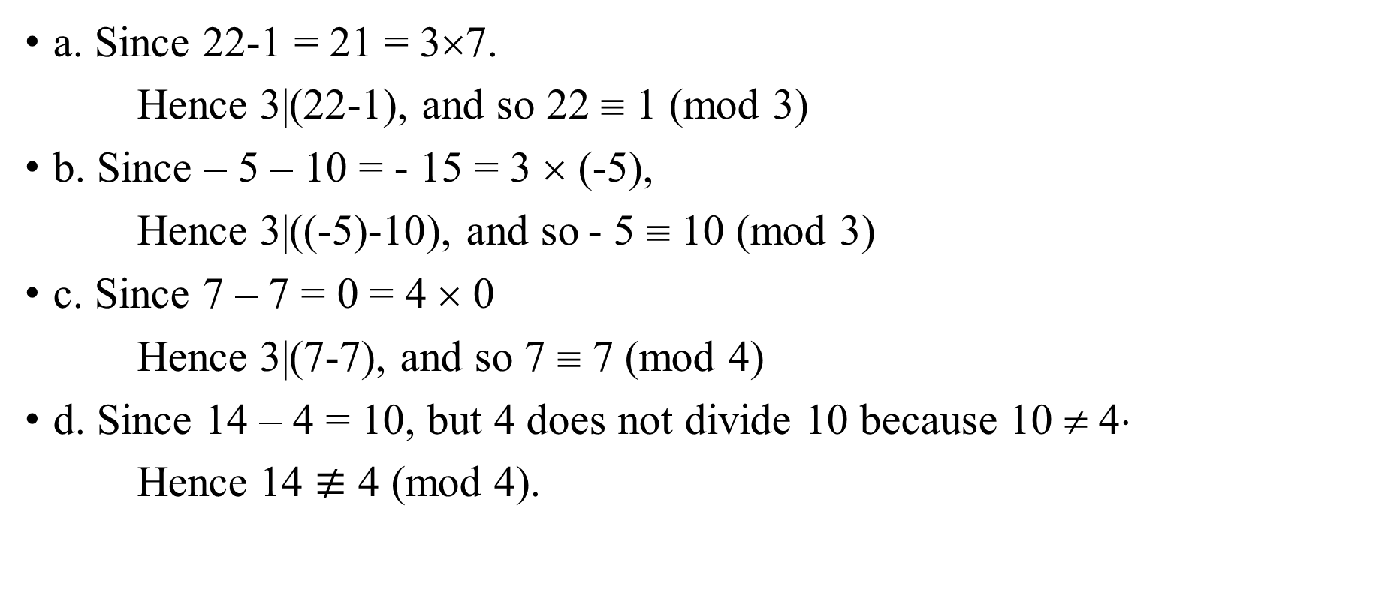
SOLUTION:
a. Since 22-1 = 21 = 3×7.
Hence 3|(22-1), and so 22 ≡ 1 (mod 3)
b. Since – 5 – 10 = - 15 = 3 × (-5),
Hence 3|((-5)-10), and so - 5 ≡ 10 (mod 3)
c. Since 7 – 7 = 0 = 4 × 0
Hence 3|(7-7), and so 7 ≡ 7 (mod 4)
d. Since 14 – 4 = 10, but 4 does not divide 10 because 10 ≠ 4⋅
Hence 14 $≢$ 4 (mod 4).

Slide 63
EXERCISE:
Define a relation R on the set of all integers Z as follows:
for all integers m and n, m R n ⇔ m ≡ n (mod 3)
Prove that R is an equivalence relation.
SOLUTION:
R is reflexive
Every element is related to itself because
iff for all m ∈Z, m R m. By definition of R, this means that
For all m ∈Z, m ≡ m (mod 3)
Since m – m = 0 = 3 ×0.
Hence 3|(m-m), and so m ≡ m (mod 3) mRm
⇒ R is reflexive.

Slide 64
SOLUTION:
R is symmetric
iff for all m, n ∈Z
if m R n then n R m.
Now mRn
m≡n (mod 3)
3|(m-n)
m-n = 3k, for some integer k.
n – m = 3(-k), -k ∈Z
3|(n-m)
n ≡ m (mod 3)
nRm
Hence R is symmetric.

Slide 65
SOLUTION:
R is transitive
iff for all m, n, p ∈Z, if mRn and nRp then mRp
Now mRn and nRp means m ≡ n (mod 3) and n ≡ p (mod 3)
3|(m-n) and 3|(n-p)
(m-n) = 3r and (n-p) = 3s for some r, s ∈Z
Adding these two equations, we get,
(m – n) + (n – p) = 3 r + 3 s
m – p = 3 (r + s),where r + s ∈Z
3|(m – p)
m ≡ p (mod 3) ⇔ m Rp
Hence R is transitive. R being reflexive, symmetric and transitive, is an equivalence relation.

